Slide 1
Spring MVC
Spring web MVC module
-> Spring Web MVC is one module in spring framework
-> Using Web MVC we can develop below types of applications
1) Web Application (C 2 B)
2) Distributed Application (B2B)
We need to use 'springboot-starter-web' dependency to work with Spring Web MVC module.
'web-starter' will provide embedded container
Apache (Default)
Jetty
Netty
➔ Spring Web MVC supports multiple presentation technologies
Ex: JSP, Thymeleaf...
- Spring Web MVC supports Form Binding. form data will be mapped to java object.
Note: When we develop java web app using servlets we need capture form data like below.
String phno = request.getParameter("phno");
Long ph =Long.parseLong (phno);
Note: We No need to write this logic in web mvc. It will take care of capturing form data and convert into corresponding data type and store into java object.)

Slide 2
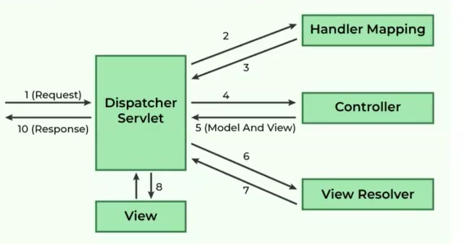
Spring Web MVC Architecture
=> In spring web mvc, below components will be involve
DispatcherServlet : front controller /framework servlet Responsible for request and response to client
2) HandlerMapper: To identify request handler
3) Controller: Request Handler (spring bean) we have to develop
4) ModelAndView Model represents data & view represents UI page.
5) ViewResolver: To identify where view pages available in app
6) View: To render model data and view page.

Slide 3
Building First Web App using Spring Boot
1) Create Boot app with below dependencies
a) web-starter
b) thymeleaf-starter
c) devtools
2) Create Controller class with required methods and map methods to HTTP methods with unique url patterns.
3) Create View Page (HTML+ Thyme leaf) (under templates folder)
4) Run the application and test it.
Form Based Applications
=> In every web app many forms will be available
- login form
- register form
Note: Web MVC supports form binding.
Develop Boot web app to save and retrieve products data
1) Product.java (form binding + entity)
Integer pid; (PK, Auto Increment)
String pname;
Double price;
Integer qty;
2) ProductRepo.java (JpaRepository)
3) ProductService.java

Slide 4
Building First Web App using Spring Boot
1) Create Boot app with below dependencies
a) web-starter
b) thymeleaf-starter
c) devtools
2) Create Controller class with required methods and map methods to HTTP methods with unique url patterns.
3) Create View Page (HTML + Thymeleaf) (under templates folder)
4) Run the application and test it.
Http and Https
→ Both HTTP and HTTPS are protocols designed for transferring hypertext across the World Wide Web.
->They operate based on a client-server model, where a client (web browser) sends a request to the server hosting a website
→ Both protocols use similar methods to perform actions on the web server as well as status codes
→ HTTP and HTTPS are both stateless protocols, meaning they do not inherently remember anything about the previous web session
→ Both HTTP and HTTPS can transfer data in various formats including HTML, XML ISON and plain text

